Slide 1
Class Practice Assignment on Neural Network

Slide 2
Class Practice Assignment on Neural Network
Problem statement:
A Pharmaceutical firm that developed a particular drug for women wants to understand the characteristics that cause some of them to have an adverse reaction to a particular drug. They collect data on 15 women who had such a reaction and 15 women who did not.
The variable measured are
Systolic Blood Pressure
Cholesterol level
Age of the person
Whether or not the woman was pregnant (1=yes)
The dependent variable indicates if there was an adverse reaction (1=yes)
Using neural network classify and predict five cases.

Slide 3
Class Practice Assignment on Neural Network
1. Load required libraries
library(MASS,lib.loc = "D:/rPackages")
library(neuralnet)
library(caret,lib.loc = "D:/rPackages")
library(pROC,lib.loc = "D:/rPackages")
library(ggplot2,lib.loc="D:/rPackages")
library(ROCR)
2. Load the data and split into training and testing sample
nn <- read.csv("D:/NN/DrugReaction.csv",header = T)
# splitdf function will return a list of training and testing sets
splitdf <- function(dataframe, seed=NULL) {
if (!is.null(seed)) set.seed(seed)
index <- 1:nrow(dataframe)
trainindex <- sample(index, trunc((length(index) * 5) / 6))
dev <- dataframe[trainindex, ]
test <- dataframe[-trainindex, ]
list(dev=dev,test=test) }

Slide 4

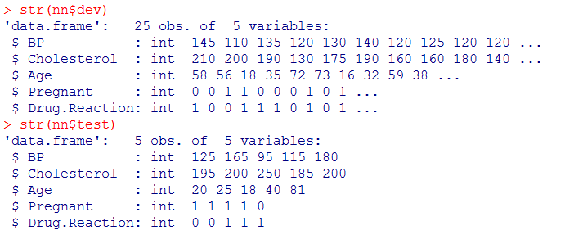
Class Practice Assignment on Neural Network
2. Split into training and testing sample
Using neural network classify and predict five cases; So, split nn
into development sample and test sample in the ratio 25:5
nn <- splitdf(nn, seed=808)

Slide 5
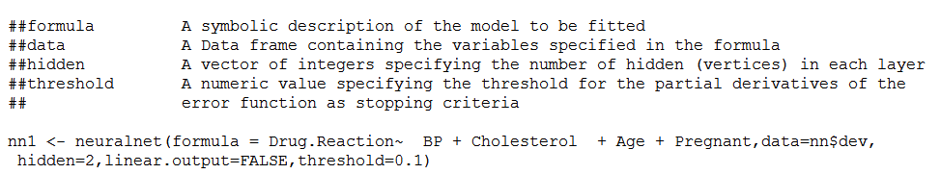
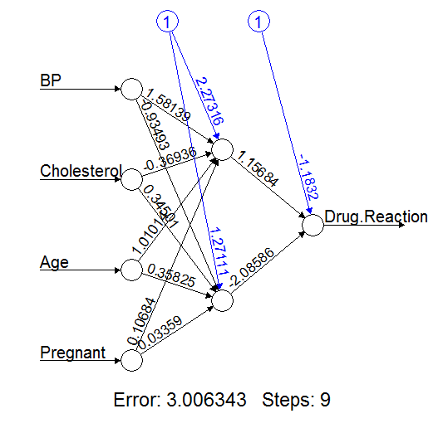

Class Practice Assignment on Neural Network
3. Train the neural network

Slide 6
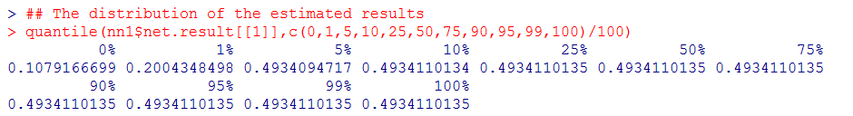
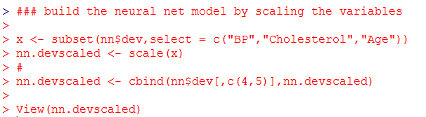
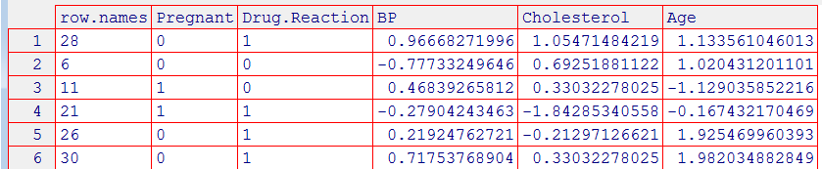
Class Practice Assignment on Neural Network
3. Train the neural network - continued
Let us scale the variables and see if it has an impact on neural network model output.
Partial View

Slide 7
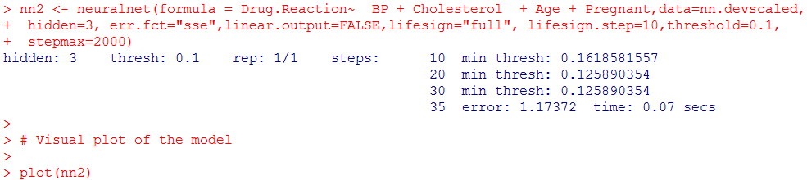
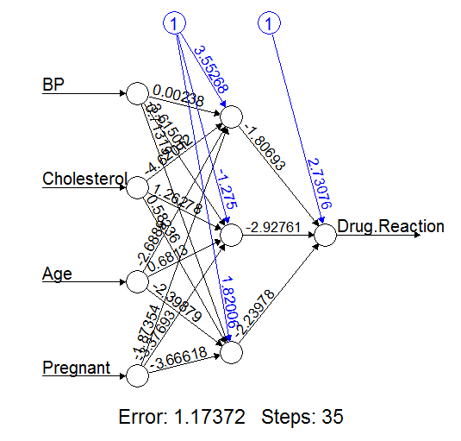
Class Practice Assignment on Neural Network
3. Train the neural network - continued

Slide 8
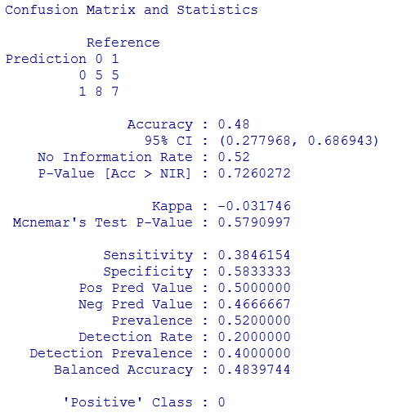
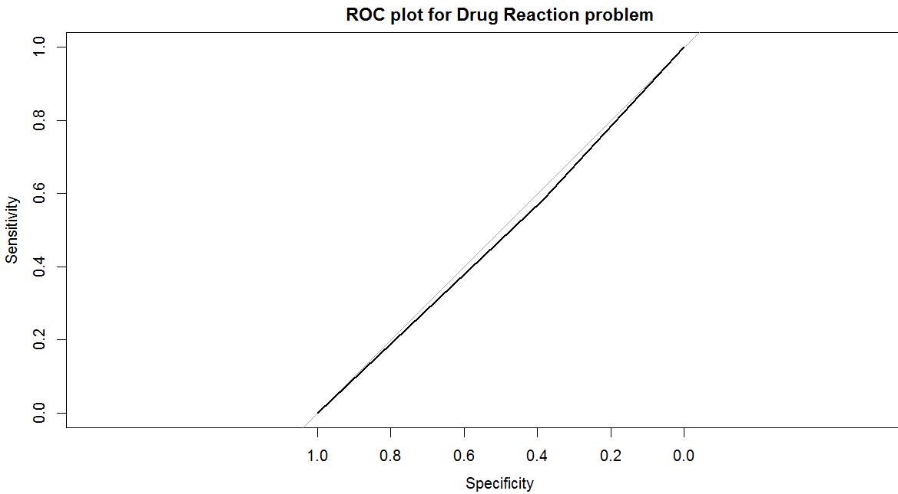
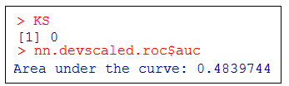
Class Practice Assignment on Neural Network
4. Model performance – Classification accuracy – training data

Slide 9
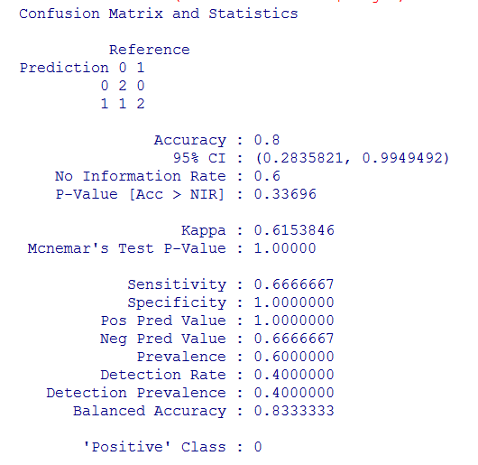
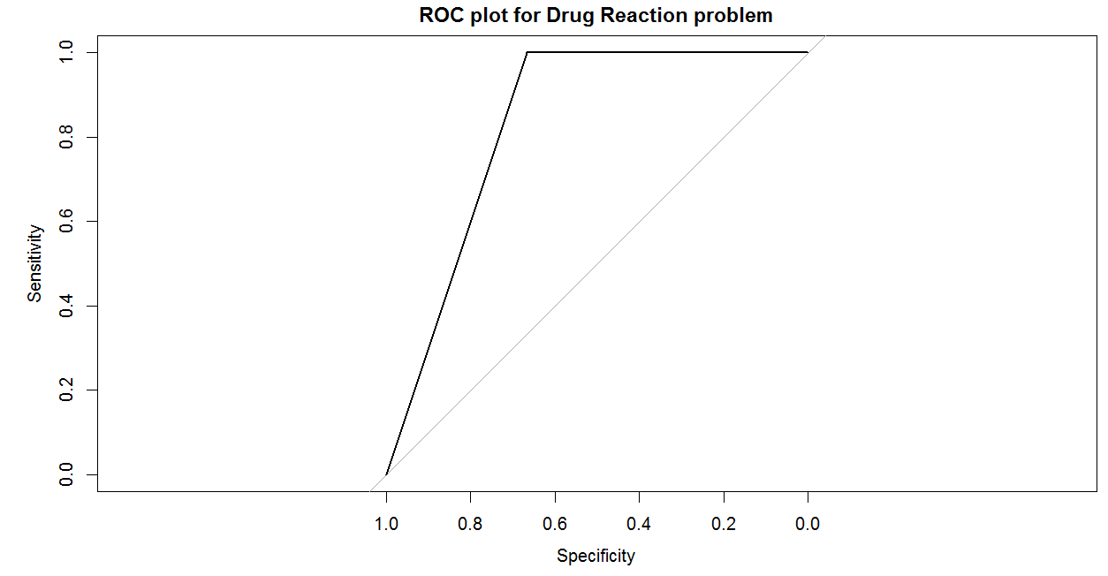
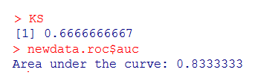
Class Practice Assignment on Neural Network
4. Model performance – Classification accuracy – test data

Slide 10
Class Practice Assignment on Neural Network
5. Interpret the results of model performance
A few thumb rules:
AUC ROC
0.90 to 1 - Excellent
0.80 to 0.90 - Good
0.70 to 0.80 - Fair
0.60 to 0.70 - Poor
below 0.60 - Fail
We observe Sensitivity of the model is:
Training data: 0.38 - Poor
Testing data 0.67 – Good
We observe Specificity of the model is:
Training data: 0.58 – Fail
Testing data: 1.00 – Good
We observe KS of the model is:
Training data: 0 - Poor
Testing data 0.67 – Good
We observe AUC ROC of the model is:
Training data: 0.48 – Fail
Testing data: 0.83 – Good
We observe Accuracy of the model is
Training data: 0.48 - Poor
Testing data 0.8 – Good

Slide 11
Class Practice Assignment on Neural Network
5. Conclusion

